Slide 2
An academy is an exciting program that will challenge you and help further your career interests.
In an academy you will…
Network with local, state, and national employers from many different industries.
Complete a job shadowing program that will allow you to see if your “dream job” is something that you really want to pursue.
Complete a internship during your senior year that will give you experience in your chosen industry.
Apply for scholarships from our local, state, and national business partners.
Earn industry certifications.
In an academy you will participate in…
Extended classroom trips (field trips)
Inside views of many different industries
Job Shadowing
Community service projects
Internships
Industry validated curriculum

Slide 3
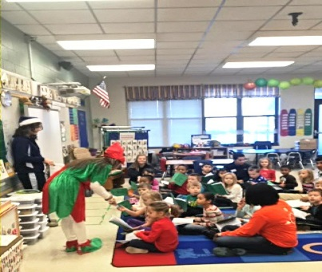
What is AOHT?
The Academy of Hospitality and Tourism is an Honors program that lasts all 4 years of high school. Each year the academy courses focuses on industry specific areas that make up a great portion of today’s job market.
In this academy you will learn and have the ability to participate in:
Extended Classroom Trips (field trips)
Getting an inside view of many different industries
Job Shadowing
Give back to the community
Internships
Industry validated curriculum
Guest Speakers
Working Portfolio

Slide 4
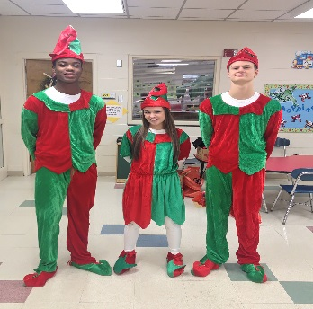
Why would I want to be in the Academy of Hospitality and Tourism?
Like to work with partners and project based instruction
Like to be creative, innovative, and problem solve
Want to give back to the community
Have strong reading and writing skills
Want to grow your public speaking and soft-skill sets
Be exposed to different businesses in the hospitality and tourism industry

Slide 5
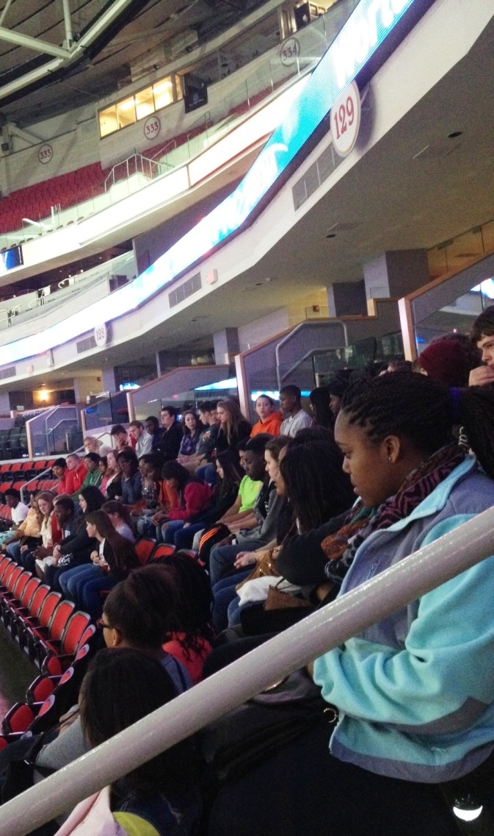
Academy of H&T Curriculum
Principles of Hospitality and Tourism / Delivering Great Customer Service
Geography for Tourism / Principles of Finance
Event Marketing / Hospitality Marketing
Sustainable Tourism / Graphic Design
All courses are considered Honors Level

Slide 6
Possible Certifications/Benefits to Academy
National Retail Federation Certification in Customer Service
ServSafe- Hospitality Industry
Career Readiness Certificate (WorkKeys)
Community College Articulation
NAFTrack certification

Slide 7
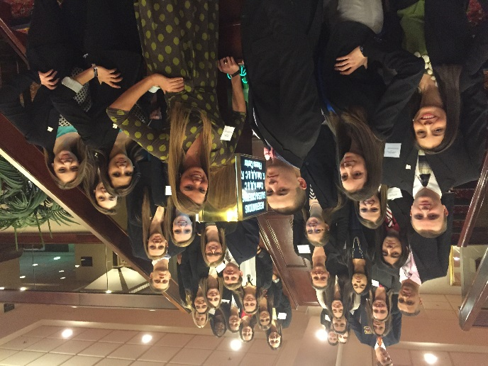
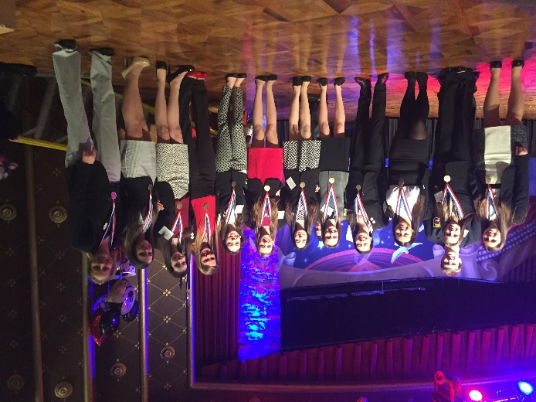
An Association of Marketing Students
DECA is a service organization that has the mission of enhancing the co-curricular education of students with interests in marketing, management and entrepreneurship.
Participate in Competitive Events at the District, State and National levels
Experience new cultures and new people
Travel to district, state, and national Career Development Conferences

